Slide 1

CMR COLLEGE OF ENGINEERING & TECHNOLOGY
Kandlakoya, Medchal, Hyderabad - 501401
Department of Computer Science and Engineering
SUICIDAL TWEETS DETECTION USING MACHINE LEARNING
Batch No:13
Name of the student:
G.Akshaya (20H51A05C3)
K.Sushmaraj (20H51A05L0)
P.Akshitha (20H51A05L5)
Under esteemed guidance of
Guide Name
Ms.T.Adarana(Assistant Professor)
Batch: 2020-2024 Major Project Phase 1

Slide 2
Outline
Abstract
Introduction
Research Objective
Problem Definition
Scope of the Project
Literature Review
Implementation of Existing system
Conclusion
References
Notes:
2

Slide 3
Abstract
Notes:
3

Slide 4
ABSTRACT
Suicidal ideathon is basically to think about talking one’s own life and is related to
Mental health problems,but people with mental disorders,insecurity,stress and a sense of
Losing control receive no treatment for their condition due to the limited accessibility to
Mental care facilities,awareness or social support.In this research,we have also used
Several sets of embedded and tweet features, and we have compared our model among
Twelve classifiers models.The results from our study reflect that our proposed model can
Accurately predict the target outcome and come up with an excellent standard for suicidal
Ideathon prediction on active social media such as Twitter

Slide 5
INTRODUCTION
Notes:
5

Slide 6
Introduction
Social media with its mental health-related forums has become an emerging study
area in computational linguistics. It provides a valuable research platform for the
development of new technological approaches and improvements which can bring a
novelty in suicide detection and further suicide risk prevention. The primary objective
of our study is to share the knowledge of suicide ideation in Reddit social media forums
from a data analysis perspective using effective deep learning architectures.
Our main task is to explore the potential of Long Short-Term Memory (LSTM),
Convolutional Neural Network (CNN) and their combined model applied in multiple
classification tasks for suicide ideation struggles. We try to test if an implementation of
CNN and LSTM classifiers into one model can improve the language modeling and
text classification performance. We will try to demonstrate that LSTM-CNN model can
outperform the performance of its individual CNN and LSTM classifiers as well as more
traditional machine learning systems for suicide-related topics.
Potentially, it can be embedded on any online forum’s and blog’s data sets.
Notes:
6

Slide 7
Research Objective
Notes:
7

Slide 8
Research objective
This research objective aims to create a robust system that can accurately identify
tweets based on their words features, thereby improving the overall
management of feeds in recognition settings. The system may have applications in
ensuring the correct matching of tweets with their past words or similarities, enhancing
security measures in neonatal units, and streamlining threat processes such as
message tracking and suicidal recognition.

Slide 9
Problem Definition
Notes:
9

Slide 10
Problem Definition
Understanding the context used by individuals who express suicidal ideation on
social media, and developing algorithms that can accurately interpret and analyze
this content.Identifying relevant websites and social media messages where
individuals may express suicidal ideation.
Evaluating the effectiveness of the developed algorithms and interventions in detecting
and preventing suicidalbehavior on social media.

Slide 11
Scope of the Project
Notes:
11

Slide 12
Scope of the Project
In the future, we schedule to improve the system for checking web pages for suicidal
content, namely:
1.Add images verification as these images may be suicidal or contain symbols of
death groups. The last one may be an indication that the website containing it belongs
to this group.
2.Add links verification on the page as they may be related to relevant websites.
3.Add checking for suicidal instructions. We also going to to improve this method in
the future by analyzing more machine learning algorithms and text processing libraries

Slide 13
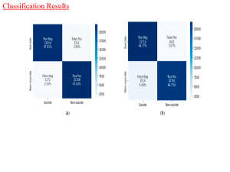
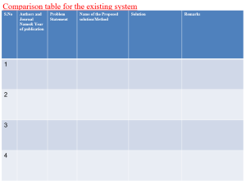
Literature Review
Notes:
13

Slide 14
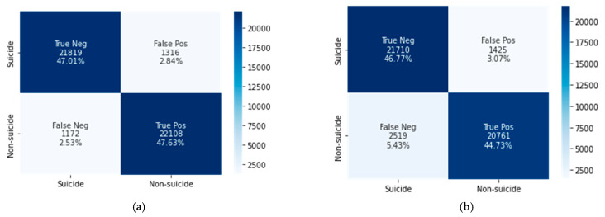
Classification Results

Slide 15
Implementation of Existing System
Context employ user profiles on social networks to identify publicly available information
such as name, gender, location, and other details. However, user's attributes are
frequently not visible owing to privacy settings, which makes these existing works flimsy.
Additionally, several researchers talk about the suicide issue.However, despite the fact
that tweets contain a wealth of data that may be used to identify users, they sometimes
leave out important information that may be present in the user's public profile traits and
help suicide detection become more accurate. We evaluate tweets and extract as many
semantic features as we can, in contrast to many previous research that neglect these
features to identify users.Second, incorporating account features into the user's tweeted
messages helps advance the process of detecting suicide.

Slide 16
Result
The vast majority of research conducted by computer scientists was conducted through
the use of feature engineering-based machine learning and deep learning representation
learning. It will be much easier for medical professionals to identify potentially suicidal
individuals and save many lives if early suicidal thoughts can be detected on microblogging
sites such as Twitter. Both the deep learning and machine learning techniques have the
potential to provide novel prospects for enhancing the early identification of suicidal
thoughts and the subsequent early prevention of suicide.
In this work, we aimed to evaluate and assess several ML and DL models for determining
whether or not user tweets include indicators indicating suicide thoughts and for
determining which models performed the best. The primary objective of the research was to
determine which model is most effective in recognizing suicidal ideations among Twitter
users and able to do so with a high degree of precision.

Slide 17
Conclusion
In conclusion, In this study, we developed and evaluated a suicide ideation detection system
using ML and hybrid DL techniques to evaluate Reddit users’ psychological states.
Our experimental results showed that the CNN–BiLSTM model outperformed the XGBoost
model, achieving 95% accuracy in detecting suicidal ideation using textual features,
compared with the latter’s 91.5% accuracy. Our analysis using the LIWC lexicon reveals that
suicidal posts score higher on authenticity, anxiety, mentality, depression, negativity, and
sentimental despondency and lower on attention, mind-thinking, perception, sociality, and
cognitive processes than non-suicidal posts. This suggests that Reddit users at risk of
committing suicide may exhibit psychological and mental health problems. Nowadays,
individuals are more sensitive than ever before, which causes major losses to their families,
friends, and others in their immediate environments. By detecting suicidal intent in user’s
posts, the proposed system may help identify individuals who require medical treatment
and reduce suicide rates.

Slide 18
References
https://ieeexplore.ieee.org/document/9528252/
https://ijcrt.org/papers/IJCRT2305418.pdf

Slide 19
Thank You!

